Slide 1


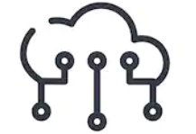
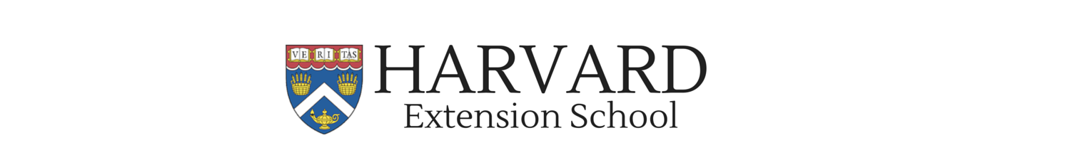
Robotics, Autonomous Vehicles, Drones, and Artificial Intelligence
Final Project Presentation (Team #3 – JBNav)
James Milliman and Bruno Janota
Monday, May 3rd, 2021

Slide 2
JBNAV LIBRARY

Slide 3
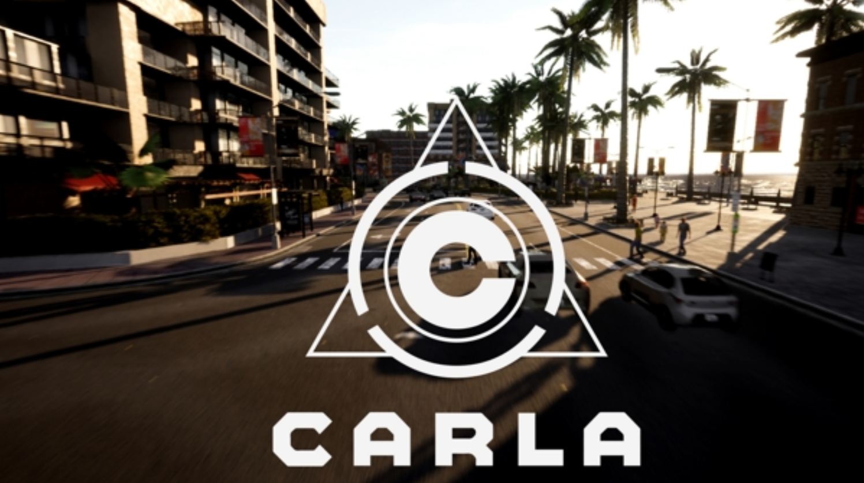
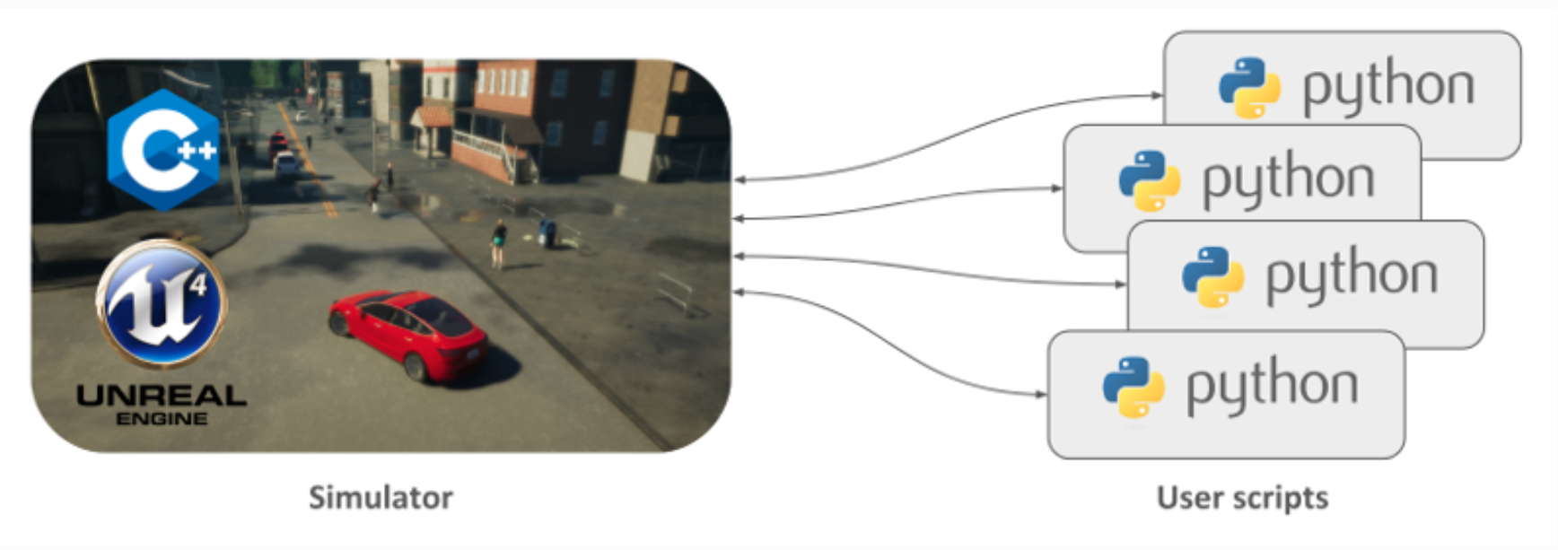
What is CARLA?
Open-source driving simulator built to support development, training, and validation of autonomous driving systems.
Realistic Graphics
Traffic
Pedestrians
Weather / Lighting
Flexible sensor suites
Simulation control via C++ and Python APIs

Slide 4
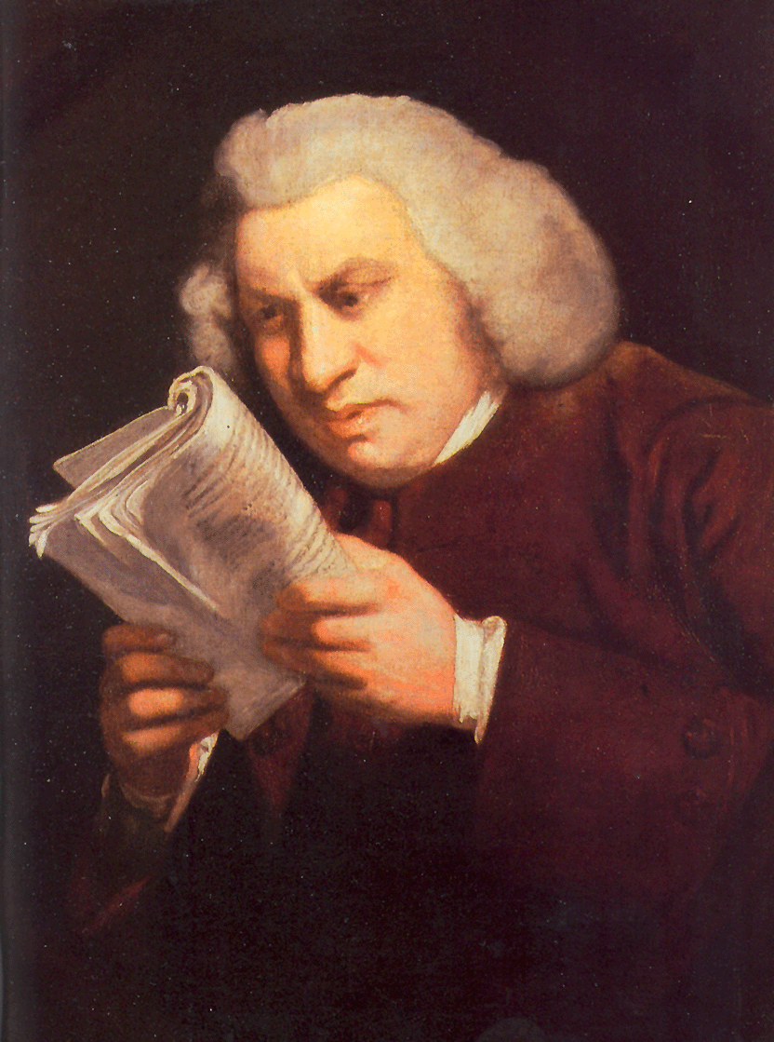
Why JBNav?
When we first began researching CARLA and reading the documentation, we found that CARLA’s documentation had a focus on developers who would help create the traffic simulator (materials, physics, etc) and wasn’t geared towards easy research
No installable library that was easy to use, working with carla required to read through example python files and modify your PYTHONPATH

Slide 5
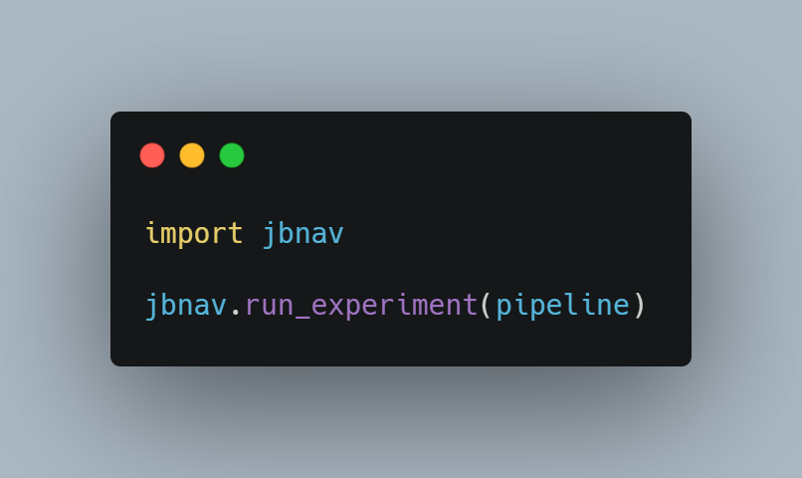
JBNAV Overview
Python Library that uses CARLA and makes deploying computer vision pipelines to CARLA for testing and vehicle control super easy

Slide 6

Use Cases
Quickly Deploy computer vision pipelines (such as this classes assignments) to various generated environments and conditions
Autonomous Agent and Policy improvement and testing (upcoming)

Slide 7
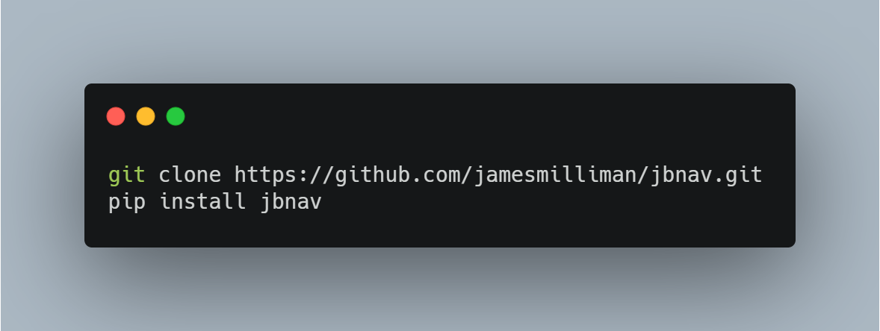
Usage Demo

Slide 8
Interesting Findings

Slide 9
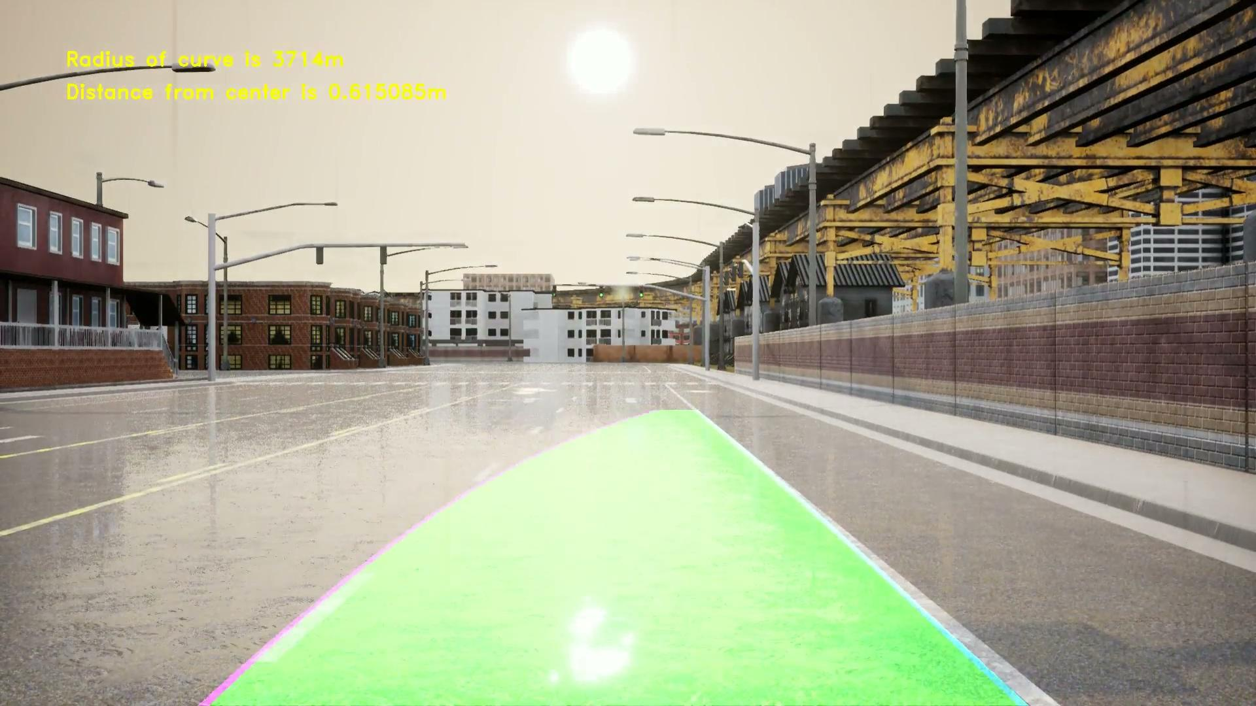
Barely Noticeable Rain (A5)

Slide 10
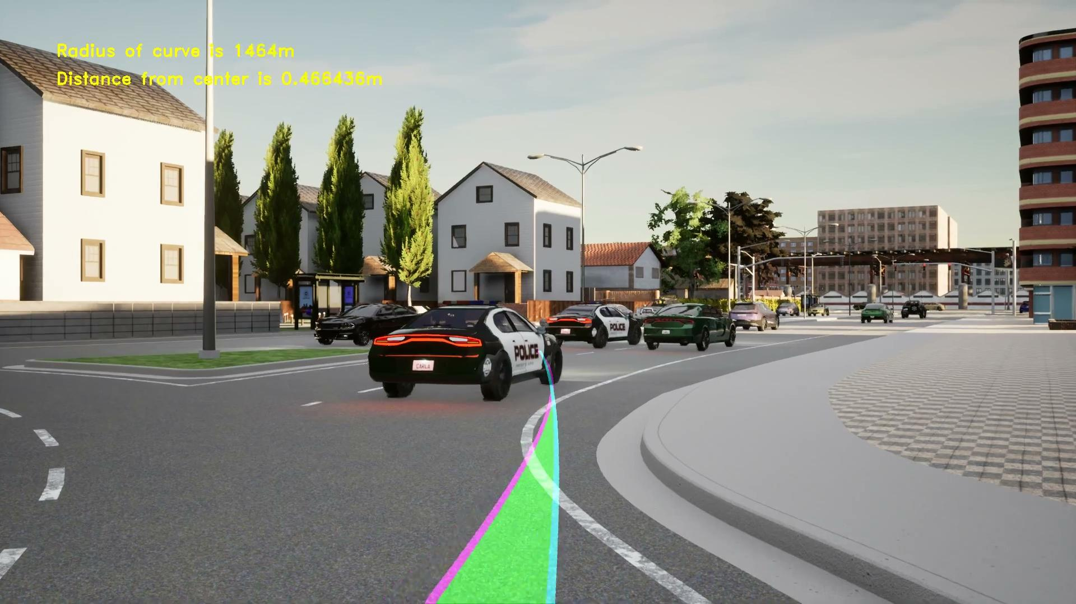
Hard Mode (A5)

Slide 11
Feature List
Weather Presets (Day, night, cloudy, sunny, wet, etc.)
Traffic generation (pedestrian and vehicle)
Client synchronous (pipeline drives the frames, meaning you won’t miss frames)
Storing of training data, processed images, etc
Autopilot or Agent Controlled Ego Vehicle
RGB camera (Full HD)
Auto-Named and stored experiments (TODO: Store metadata in experiment file for replaying experiments)

Slide 12
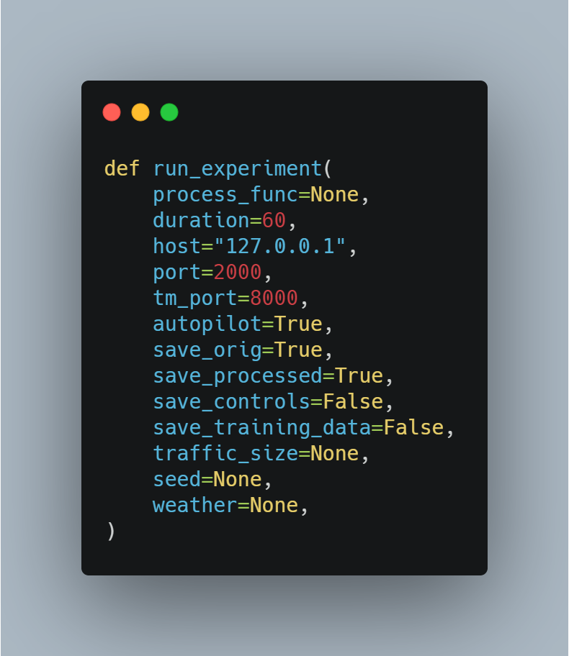
Experiment Entrypoint

Slide 13
IMITATION LEARNING

Slide 14
Data Overview
Dataset can be downloaded here: CARLA Imitation Learning (24 GB)
The data is stored on HDF5 files where each HDF5 file contains 200 image and control/state information stored in two datasets: “rgb” and “targets”
The “rgb” datasets contains 200x88 resolution images
657,800 images to train and 74,800 images for validation
The “targets” dataset includes all the controls and measurements collected:
Simulation Control Variables and State Information
1. Steer, float 2. Gas, float 3. Brake, float 4. Hand Brake, boolean 5. Reverse Gear, Boolean 6. Steer Noise, float 7. Gas Noise, float | 8. Brake Noise, float 9. Position X, float 10. Position Y, float 11. Speed, float 12. Collision Other, float 13. Collision Pedestrian, float 14. Collision Car, float | 15. Opposite Lane Inter, float 16. Sidewalk Intersect, float 17. Acceleration X,float 18. Acceleration Y, float 19. Acceleration Z, float 20. Platform time, float 21. Game Time, float | 22. Orientation X, float 23. Orientation Y, float 24. Orientation Z, float 25. High level command, int 26. Noise, Boolean 27. Camera (which camera was used) 28. Yaw Angle

Slide 15
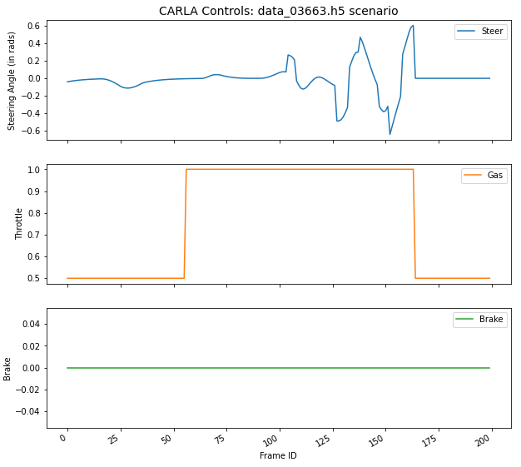
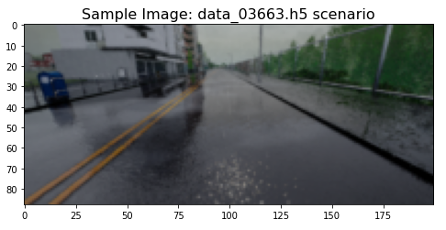
Example Image and Controls
Each scenario consists of 200 frames and associated control states

Slide 16
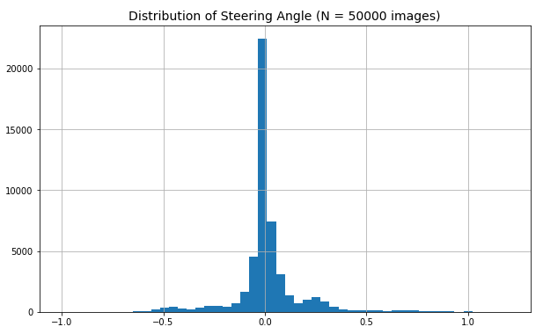
Target Distribution

Slide 17
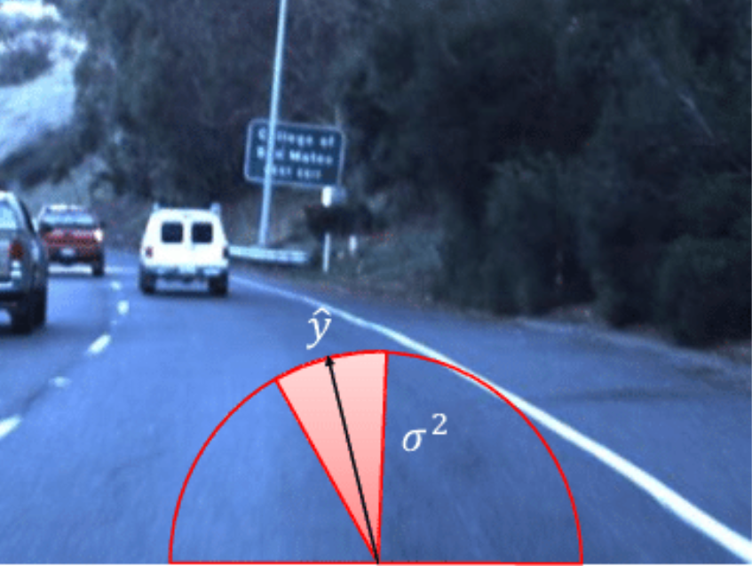
Imitation Learning Pipeline
Initial scope focused on predicting steering angle based on simulation images
Experimented with three model architectures:
CNN with single image input
Multi-Input CNN/Dense network with images and state information (position, acceleration, etc.)
Transfer Learning with image input
Image courtesy of ResearchGate

Slide 18
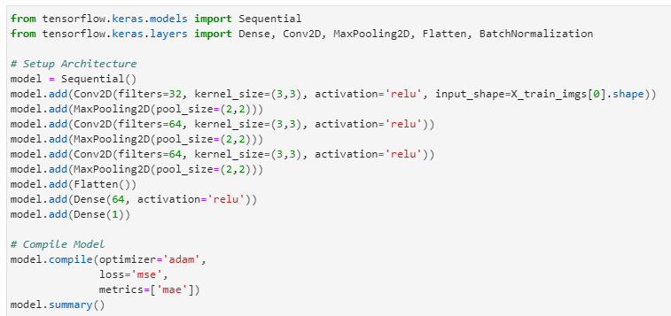
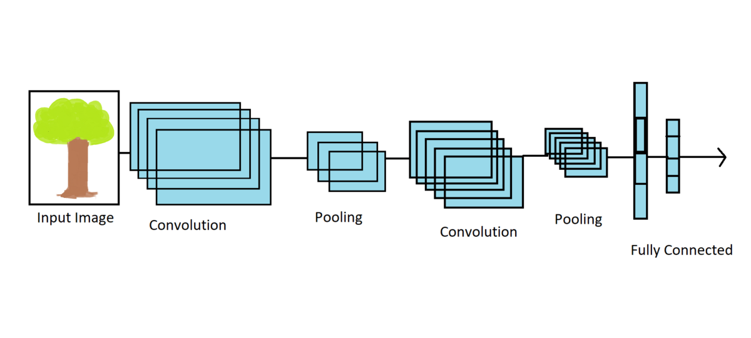
Convolutional Neural Network
Experimented with LeNet style architecture and various filter sizes, depth, and batch normalization. The network below achieved the best validation result: MAE = 0.0919 rads
Image courtesy of DebuggerCafe

Slide 19
Steering Prediction Example

Slide 20
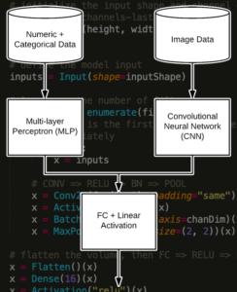
Multi-Input CNN/Dense Network
Leveraged Tensorflow Functional API to create multiple input model
Input 1: Images to be processed by CNN
Input 2: Position, Acceleration, and Speed numeric vector to be processed by MLP
The outputs from each network were combined and passed to a fully connected output layer
Image courtesy of PyImageSearch

Slide 21
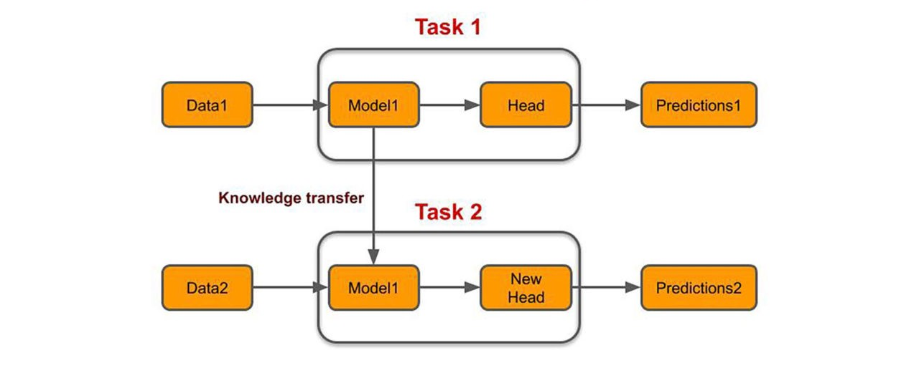
Transfer Learning
(i.e. ImageNet Classification)
14MM images
22k categories
(i.e. Steering Angle Prediction)
50k images
Regression

Slide 22
Ideas for Future Work
Leverage sequence information (past images, steering angles, change in position, etc.) to predict the next state for steering angle
Tensorflow’s TimeDistributed and/or ConvLSTM layers which may be helpful
Implement DAVE-2 architecture from Nvidia’s end-to-end self-driving car paper which includes image preprocessing/augmentation
https://developer.nvidia.com/blog/deep-learning-self-driving-cars/
Train with more data (only used 50k images in this project)
Predict multiple output states (i.e. throttle, brake, etc.)

